Slide 1
Automatic Translations
Skillshare
Zombieland CLI Team (cohort 10)
Carlos Andres Garcia (agzsoftsi)
Leonardo Calderon (leocjj)
Ivan Dario Lasso (ilasso)
June 2020

Slide 2



Slide 3

Overview
0. Team members/roles
1. Company
2. The inspiration for the project
3. Technologies & Architecture
4. Core algorithms/code snippet
5. Process, collaboration, and timeline
6. Main challenge overcome
7. Live Demo (front-end, back-end)
8. Learning lessons
9. Questions session

Slide 4
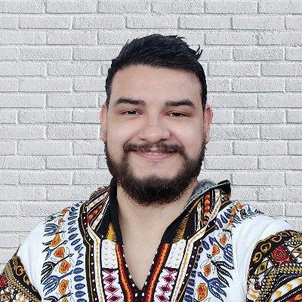


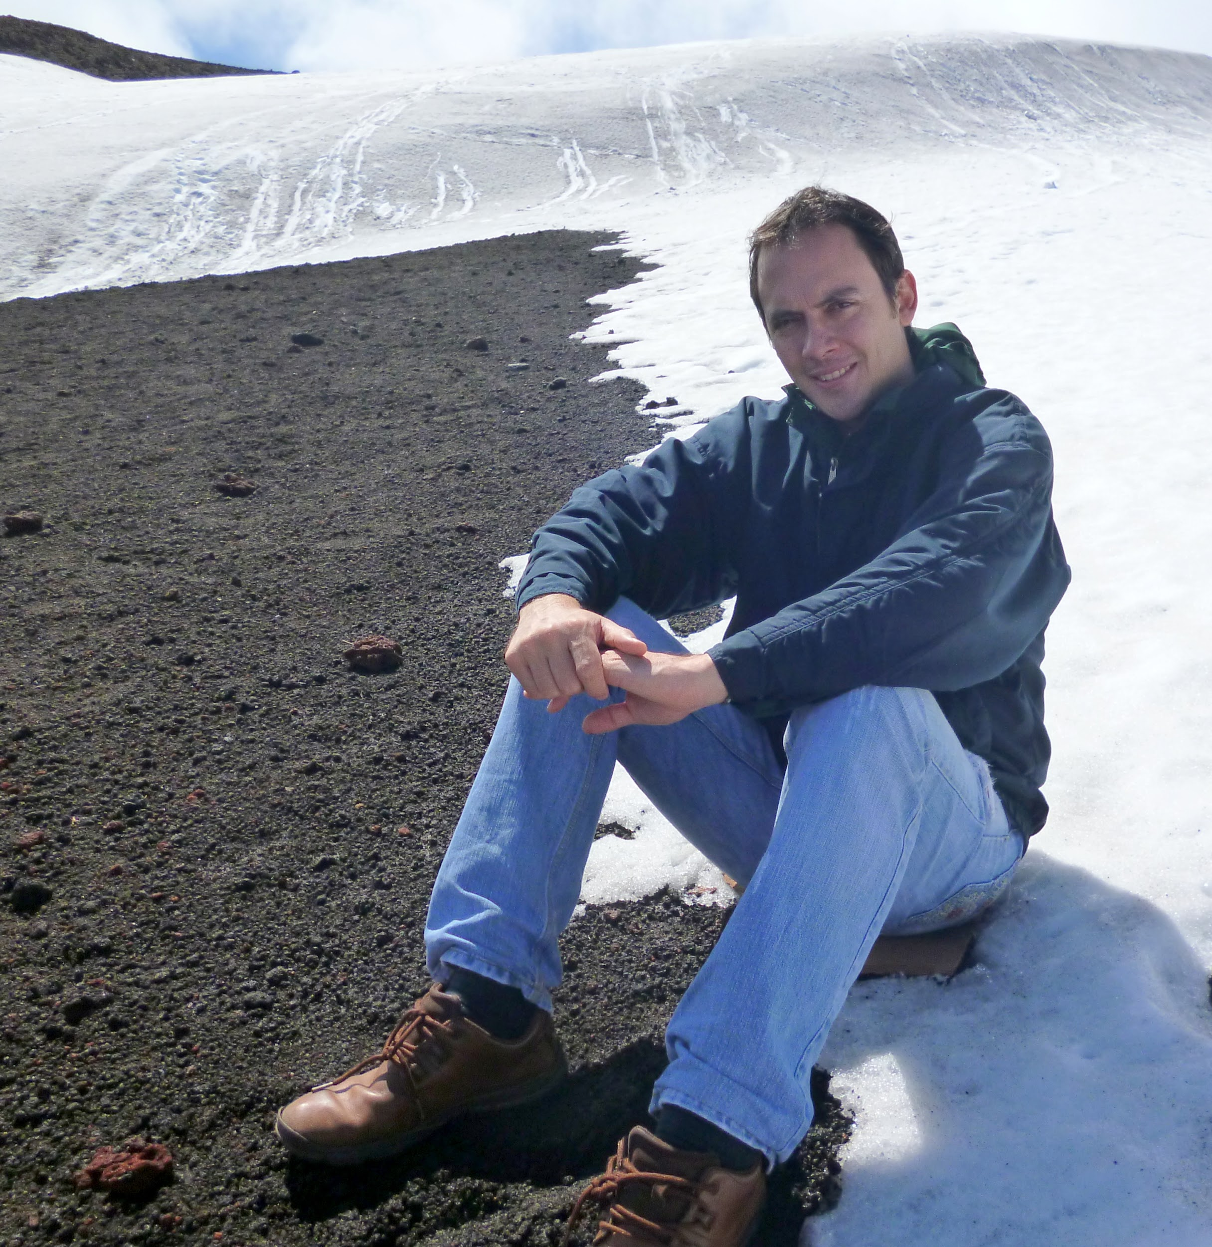
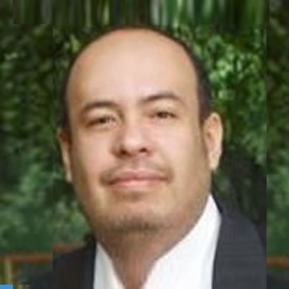
Team and roles
FrontEnd and Design:
HTML, CSS, Javascript, AWS CloudFront,
AWS S3
Carlos A. García M., SWE
@karlgarmor agzsoftsi
BackEnd:
Python, AWS Lambda, AWS API Gateway, AWS S3
AWS Translate
Leonardo Calderon J., SWE
@leocj leocjj
FrontEnd and Testing: HTML, CSS, Javascript, AWS CloudFront,
AWS S3
Ivan D. Lasso G., SWE
@ilasso ilasso

Slide 5
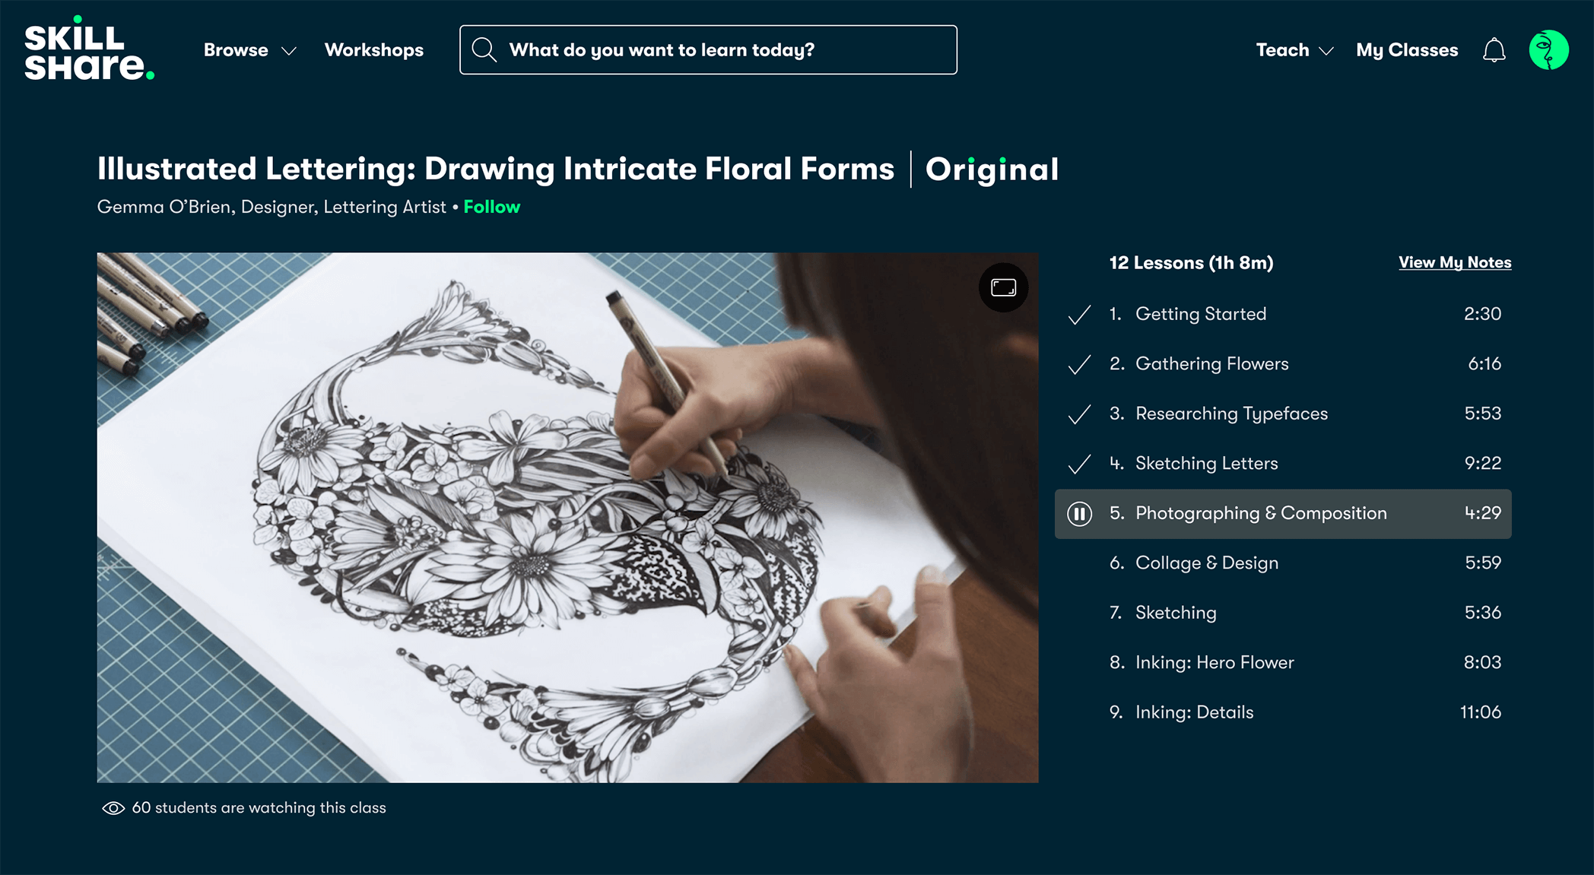
Skillshare
Online learning community
Learning from educational videos
Available through subscription
Focus on interaction, with the primary goal of learning by completing a project.

Slide 6
The inspiration for the project
Skillshare wants to go beyond English spoken users.
Online translation for transcriptions in several languages.
1
1
2
Videos and transcriptions are in English.
2
Automatic process without affecting user experience.

Slide 7
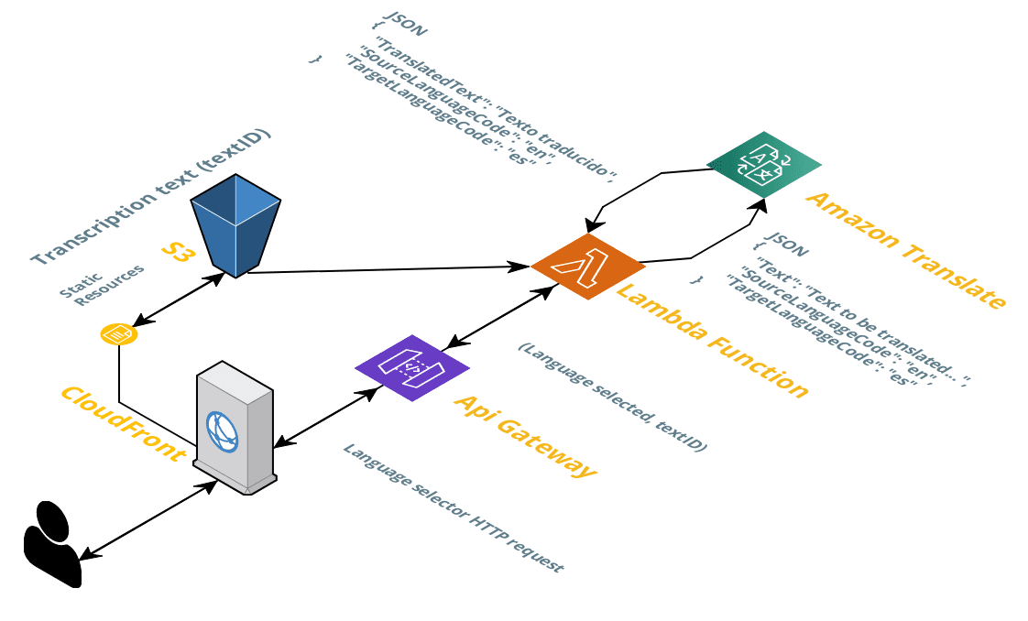
Technologies & Architecture
AWS - Amazon Web Services:
Lambda function (Python)
S3 objects
API Gateway
Translate
Comprehend
JSON format

Slide 8
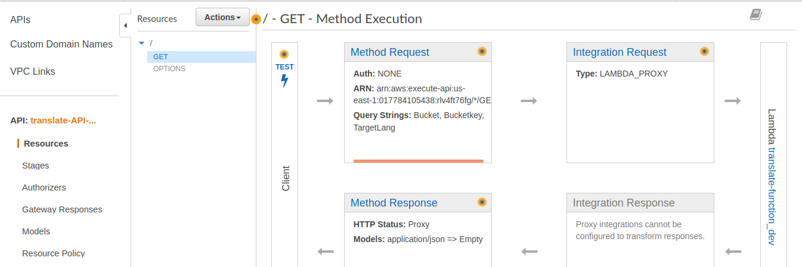
Core algorithms/code snippet

Slide 9
lambda_function.py
def lambdaFunction(key, targetLang):
resp['headers']['targetKey'] = key[:key.rfind('.')] + '_' + targetLang + '.srt'
''' IF ORIGINAL TRANSCRIPTION STORED IN S3 IS NOT FOUND, RETURN 404'''
if not keyExist(key):
resp['body'] = dumps('Video transcription not found')
return resp
'''GET STORED TRANSLATION, IF NOT, TRANSLATE TRANSCRIPTION AND STORE IT'''
if keyExist(resp['headers']['targetKey']):
translationFile = s3Client.get_object(Bucket=bucket, Key=resp['headers']['targetKey'])
resp['body'] = translationFile['Body'].read().decode("utf-8")
resp['statusCode'] = 200 # Ok
return resp
else:
# To get S3 object with original transcription
response = s3Client.get_object(Bucket=bucket, Key=key)
text = str(response['Body'].read().decode('utf-8'))
# Detect source language by sending first 100 characters to check
responseLanguage = comprehendClient.detect_dominant_language(Text=text[:100])
if responseLanguage['Languages'][0]['Score'] <= languageThreshold:
resp['statusCode'] = 412 # Precondition Failed
resp['body'] = dumps('Video language not soported')
return resp
sourceLang = responseLanguage['Languages'][0]['LanguageCode']
from boto3 import client
from json import dumps
from os import environ
def lambda_handler(event, context):
'''
This function is called from an API Gateway (translate-API),
receive three parameters inside an array to get a translation.
'''
key = event['queryStringParameters']['Bucketkey']
targetLang = event['queryStringParameters']['TargetLang']
return lambdaFunction(key, targetLang)

Slide 10
lambda_function.py
def translateBatches(sourceLang, targetLang, text):
''' Translate text in batches of step size but with cutting rows of file '''
lenn = len(text)
if lenn <= step:
try:
translatedText = translateClient.translate_text( Text = text,
SourceLanguageCode = sourceLang,
TargetLanguageCode = targetLang
)
except translateClient.exceptions.ClientError as e:
if e.response['Error']['Code'] == "500":
resp['statusCode'] = 500 # Internal error
return None
return translatedText.get('TranslatedText')

Slide 11
Collaboration
Scrum based process
Timeline
All the teamwork was performed remotely
Individual accounts for Skillshare and AWS
Development repository in GitHub
Internal team rules:
Daily meeting with the Client representative.
Two daily team meetings
To share individual research
To do pair programming to integrate codes.
Special rule to avoid migration to production code without the approval of all the team.
The Sprint: weekly, Friday to Thursday
Sprint Planning: each friday
Daily Scrum Mo-Th, 11 am.
Sprint Review: each thursday
Sprint Retrospective: each friday
May 15
May 22
May 29
June 5
June 12
June 19
Proposal
MVP definition
Project plan
Status report 1/3
Status report 2/3
Final status report
.
.
.
.
.
.

Slide 12
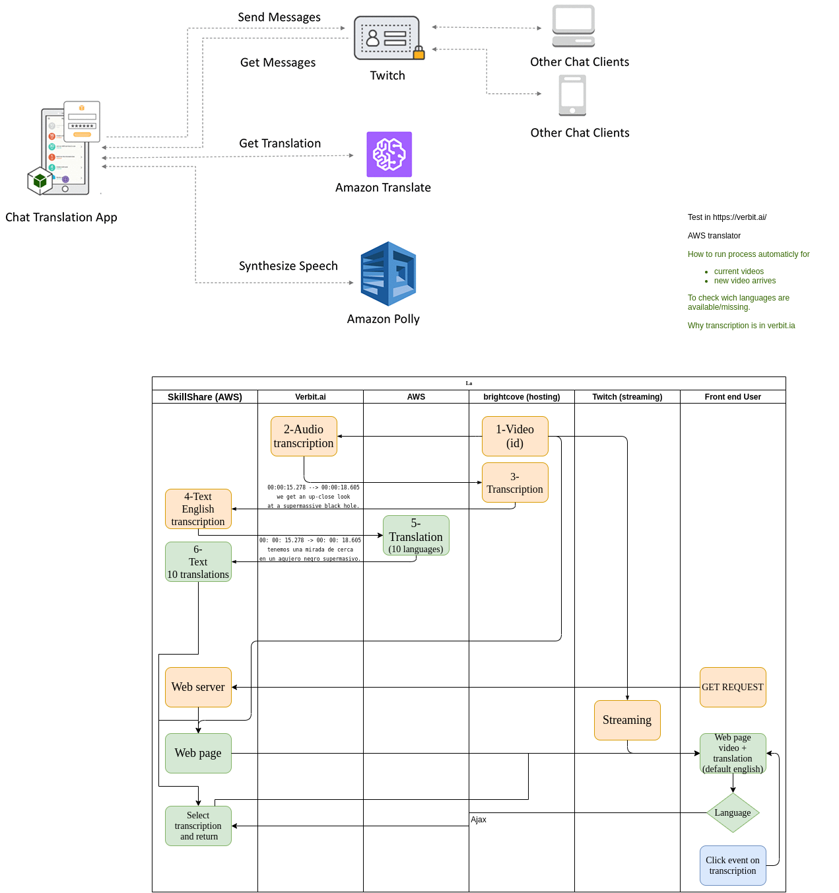
Main challenge overcome
Initial architecture definition has struggled because of technical details not well known by the client representative.
However, his trust in our decisions helped.

Slide 13
Live demo
Landing page:
https://transcriptions-translations.s3.amazonaws.com/landing/index.html
MVP:
https://transcriptions-translations.s3.amazonaws.com/index.html
API test:
https://ytuln8zsz1.execute-api.us-east-1.amazonaws.com/translatetext?TargetLang=es&Bucketkey=formats/video1t.srt

Slide 14




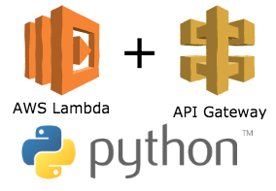
Learning lessons
01 | To define architecture with an extended team.
02 | Scrum helps to organize, prioritize, and develop.
03 | Well defined team rules help during the journey.
04 | To use the right technology rather than use “the best”.
05 | We are capable to learn what we need.

Slide 15
Thank you.
Holberton School Silvia Guzmán Johanna Alzate Laura C. Sánchez Andrés Barreto Cohort 10 Cali peers
We made it, keep moving.

